Slide 1
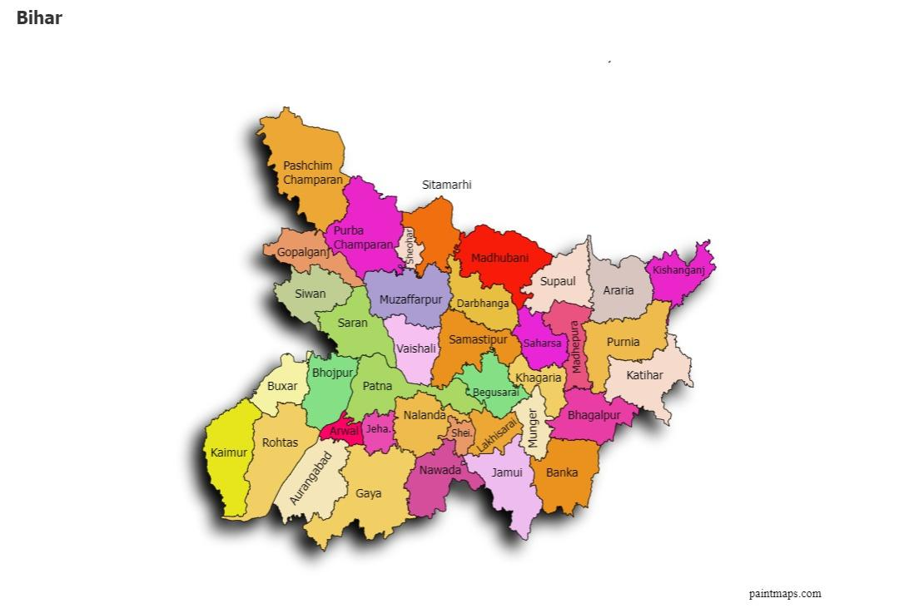
RURAL DEVELOPMENT & LIVELIHOODS | HACK FOR SOCIAL CAUSE
POTAT SMARTLINK
From farm loss to rural prosperity
A village-level system that connects potato farmers to better storage,
smarter selling and local processing.
PROBLEM + CONCEPT • BIHAR, INDIA
Think global. Build local. Keep value in the village.

Slide 2
02 | THEME
Rural development begins when value stays local
Theme: Rural Development and Livelihoods
SAVE
Reduce avoidable spoilage
THE LOCAL CHALLENGE
Careful handling + storage monitoring
Potatoes are produced in villages, but value is often lost after harvest.
SELL
Improve market access
Price information + group selling
Farmers need practical services close to the farm—not only more production.
Create village jobs
EARN
Sorting, packing, transport, processing
People • Technology • Local enterprise

Slide 3
03 | THEME DESCRIPTION + SDG ALIGNMENT
A local potato value-chain hub with global goals
The idea links farm-level action with partnerships, skills and inclusive rural enterprise.
SDGs MOST DIRECTLY SUPPORTED
WHAT THE THEME MEANS
1
NO POVERTY
2
ZERO HUNGER
Use simple digital tools to solve a real village problem.
Better value captured by farmers
Less food lost after harvest
Build shared services that small farmers can access.
5
GENDER EQUALITY
8
DECENT WORK
Women-led grading & packing groups
Local jobs and enterprise
Create paid roles for rural youth and women.
9
INNOVATION
12
RESPONSIBLE USE
Affordable monitoring + hub infrastructure
More of each harvest gets used
Connect farmers, FPOs, panchayats, storage operators, buyers and training institutions.
17
PARTNERSHIPS
FPOs + panchayat + buyers + technical partners
3/7

Slide 4
04 | PROBLEM STATEMENT
High production does not guarantee a fair return
Bihar is a major potato producer—but post-harvest handling and market gaps can reduce farmer income.
5–10%
8.2
14.4%
reported loss range
million tonnes
of India’s output
At village-trader and trader stages in an older AGMARKNET profile
Bihar potato production, 2023–24
Bihar’s share, 2023–24
WHERE VALUE LEAKS
01
Harvest & handling
02
Storage access
03
Market pressure
04
Surplus produce
→
→
→
Bruising, poor sorting
Cost, distance, limited information
Price uncertainty; distress selling
Limited nearby processing options
Core problem: small farmers lack an affordable, coordinated village-level service to protect quality and choose when and where to sell.

Slide 5
05 | SOLUTION DESCRIPTION
One hub. Four connected services.
Potato SmartLink is a shared village collection and service point—not an expensive new mega cold store.
COLLECT & GRADE
MONITOR
1
2
Weigh, sort, remove damaged tubers and pack in ventilated crates.
Low-cost temperature / humidity sensors log conditions in the holding area; alerts flag unusual readings.
STORE & SELL
PROCESS SURPLUS
3
4
Farmers see nearby storage availability and indicative mandi prices; FPO coordinates group transport and sale.
Suitable surplus or small-grade potatoes go to local units for chips, flakes or peeled-cut products, subject to food-safety compliance.
Unique feature: storage + market intelligence + processing + local jobs in one farmer-owned / FPO-coordinated model.
Unique feature: storage + market intelligence + processing + local jobs in one farmer-owned / FPO-coordinated model.

Slide 6
06 | WORKING PROTOTYPE
A low-cost pilot that can be tested in one village
Prototype goal: demonstrate traceability, condition monitoring, buyer matching and transparent farmer decisions.
FARMER
COLLECTION HUB
SENSOR UNIT
SMARTLINK
ACTION
→
→
→
→
Register lot
Village + weight
Weigh + grade
Crate + QR tag
Temp / RH log
Alert on threshold
WhatsApp / SMS
Price + buyer list
Store • sell • process
Record outcome
WHAT WE BUILD FIRST
PILOT TEST (FIRST 8–12 WEEKS)
One digital form / spreadsheet for farmer and lot registration.
Partner with one FPO / SHG and an existing licensed storage operator. Track: quantity received, damaged quantity, storage cost, sale price, time to sale, farmer payment and jobs created. Compare with the farmers’ usual method.
QR label or numbered tag for each crate / batch.
Off-the-shelf temperature-humidity sensor with phone dashboard.
WhatsApp / SMS alerts and daily price board.
Safety & realism: sensors monitor conditions; they do not replace proper potato curing, ventilation or approved cold storage.

Slide 7
07 | EXPECTED IMPACT + IMPLEMENTATION
Scale by proving value in one village first
0–3 MONTHS
4–6 MONTHS
7–12 MONTHS
Build & validate
Operate & measure
Expand carefully
Select pilot village; map farmers and storage; test sensor + QR + price board.
Run collection days; onboard buyers; train youth and women in grading, records and packing.
Add nearby villages only if loss, income and job indicators improve.
MEASURE, DON'T ASSUME
Farmers
Net price received; payment time
Food
Share of stock spoiled / rejected
Jobs
Paid workdays for youth and women
Enterprise
Hub cost recovery; repeat buyers
The ask: pilot partners, an FPO, a storage operator, local government support and technical mentors.
Sources: Ministry of Agriculture, Agricultural Statistics at a Glance (2024), Table 2.49(b); AGMARKNET, Post-Harvest Profile of Potato; United Nations SDGs.
7/7

